Slide 1


APPLYING BIOGAS TECHNOLOGY
FOR
CONVERTING THE FOOD WASTE INTO USEFUL RESOURCE
Urja Bio System Pvt. Ltd.
302, Amelia, Rege Path, Lakaki Road
Model Colony, Shivajinagar, Pune -411006
Phone - +917774043040
www.urjabiosystems.com

Slide 2

URJA BIO SYSTEM PVT. LTD.
1
More than 250 installations of Biogas to power generation projects across India.
2
15 Years extensive Experience in waste treatment sector
More Than 10,000 installation of Family size plants in Maharashtra
3
4
15 Projects for Community based biogas for Villages, 5 CBG projects

Slide 3
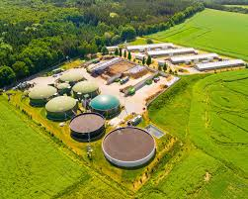

BIOGASS CONCEPT
The Term Biogas refer to the mixture of gases primarily containing CH4 (Methane), CO2(Carbon dioxide) trace of H2S originated from anaerobic ( in absence of oxygen ) degradation of organic material.
Wet waste will be treated in the Bio gas plant to generate Bio methane.
The Bio-methane is a very reliable fuel for cooking food or can also be converted in to Electricity for street lights or for pumping the water.
Bio gas plant also gives one more important bi product i.e. high quality organic fertilizer, which can be used in the Garden of the urban areas.

Slide 4

CURRENT SCENARIO ABOUT FOOD WASTE
90% goes on Open dumping
8% composting
2% getting convert

Slide 5
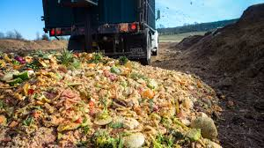
What Is Kitchen / Food Waste ?
Kitchen waste is defined as left-over organic matter from restaurants, hotels and households . Tons of kitchen wastes are produced daily in highly populated areas. It is expected that India is producing @ 1.5 lakh MT/ day food and vegetable waste .
The availability of this huge amount of waste and its potential for causing severe problems in our society , make kitchen waste an ideal feed stock for anaerobic biodegradation.
This picture show the current scenario of food waste dumping on open sites and shows the necessity of treating this waste .

Slide 6
HEALTH & ENVIRONMENTAL ISSUES
Shortage of Land for Disposal
Water Pollution
Air pollution
Health Issues

Slide 7


URJA’S ACTION PLAN
Waste Audit
Energy Management
Identify bulk waste generators
Understand waste generation pattern
Understand utilization application
DPR for subsidy / CFA claim
Engineer, Procure & Commission waste management optimized to site
Comprehensive O&M Services
Long Term Service Agreements
Utilization of gas for Green Energy production like Power , CBG etc.
Assistance in Bio – Fertilizer formulation as per crop need.

Slide 8

HOW BIOGAS PLANT WORKS ?
Effluent …
Ammonium N
Phosphorus
Potassium
Influent …
Organic N
Ammonium N
Phosphorus
Potassium
Digester
Slurry
Settled solids
Anaerobic digesters do not significantly reduce manure nutrient content.
Solids accumulated in the bottom of the digester also contain some P & N
Ammonium N increases as Organic N is transformed in the anaerobic process.
Nutrients are not reduced through the anaerobic process

Slide 9
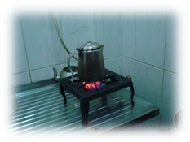
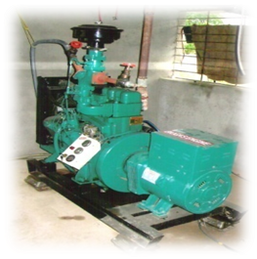
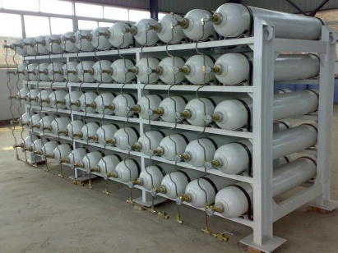
OPTIONS FOR BIOGAS UTILIZATION
Heating / cooking Application
Biogas Storage
Biogas Up gradation
Electricity Generation
Biogas....
CH4
CO2
Trace gases
Biogas CNG For Cylinder Filling
Biogas Digester

Slide 10

FEW NAMES OF BIOGAS
PROJECT BASED ON FOOD WASTE
Vengurla Municipal Corporation - 3TPD (First Award Winner for SWM)
Ambejogai Nagar Parishad – 5 TPD,
Parbhani Nagar Parishad – 10 TPD.
Akola Municipal Corporation – 10 TPD.
Baramati Nagar parishad- 5 TPD .
Raymond Industrial canteen, Yevatmal
Xavier School of Management, Jamshedpur
Collage of Military Engineering , Pune
University of Petroleum and Energy Studies, Dehradun
Allana, Zahirabad , BPCL, Nagpur
L&T, Chittapur , Hotel Muti Spice, Pune , MGM, Aurangabad
Crompton Greaves, Ahemadnagar.
Institute for Career Development, Kollam, Kerala..
…..and Many More .

Slide 11
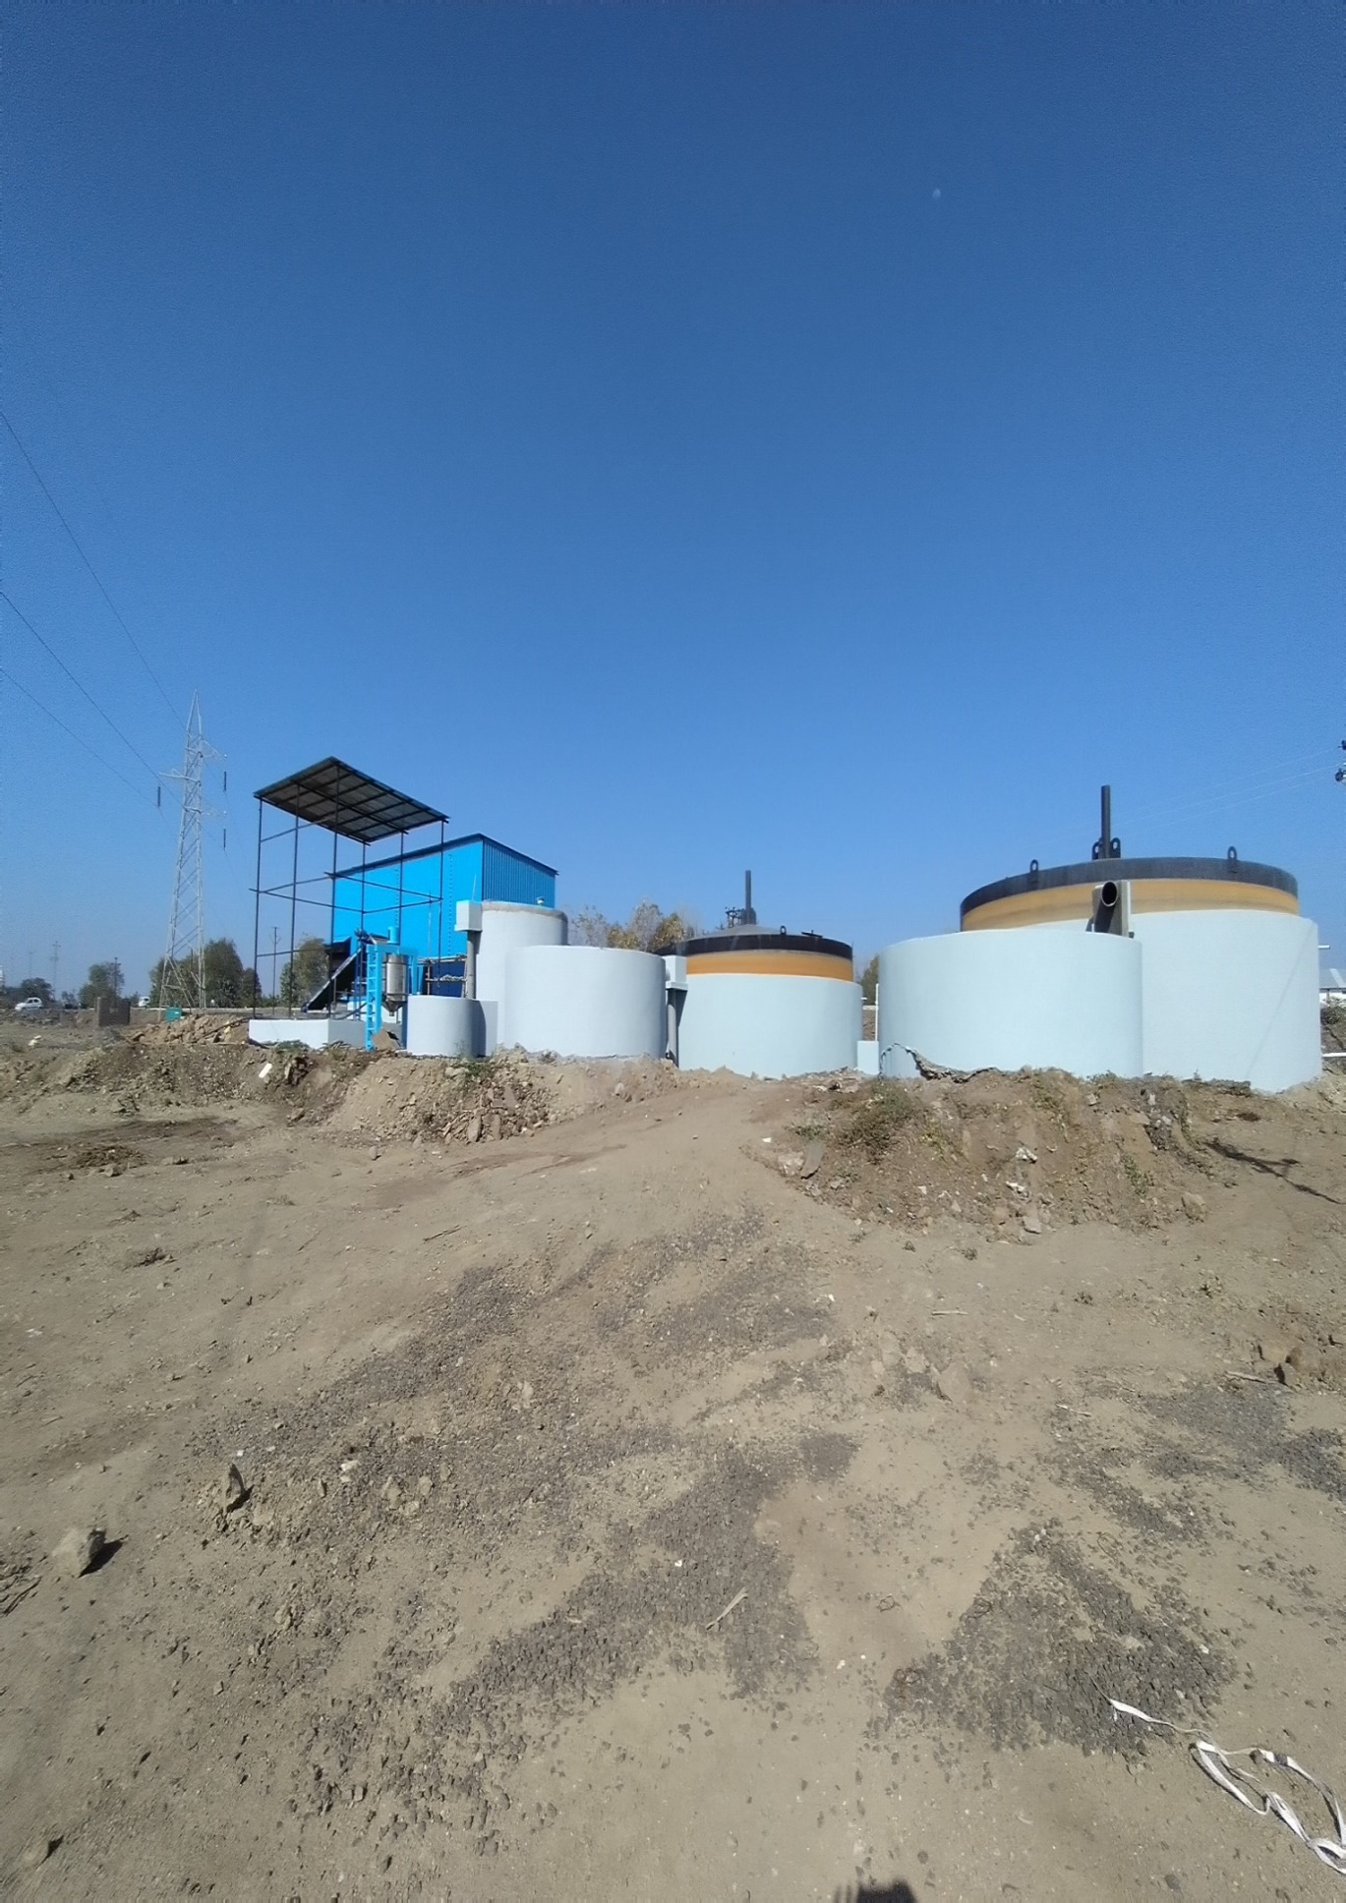
CASE STUDY- 10 TPD WASTE TO ENERGY PROJECT BASED ON FOOD WASTE
Parbhani Municipal Corporation
Capacity of Biogas Plant = 10 TPD
Feed = Food/ Vegetable waste from nearby area
Quantity of biogas = 600 m3 /day ,
Power generation = 1000 units / day

Slide 12
Output from the Plant –
a) Electricity generation = 100 KW for 10-12 hrs. ( 700 units/day)
b) Organic Manure Generation = 20,000 lit/ day
Project Cost = Rs.250 lakh ( for power )
Savings –
On Diesel (disposal cost from Parbhani to Disposal site )
= Rs.1000/ T x 10 TPD x 350 days = Rs.35 Lakh / yr.
Saving from power 1000 units/day x Rs.10/ unit x 350 = Rs.35 lakh /annum

Slide 13
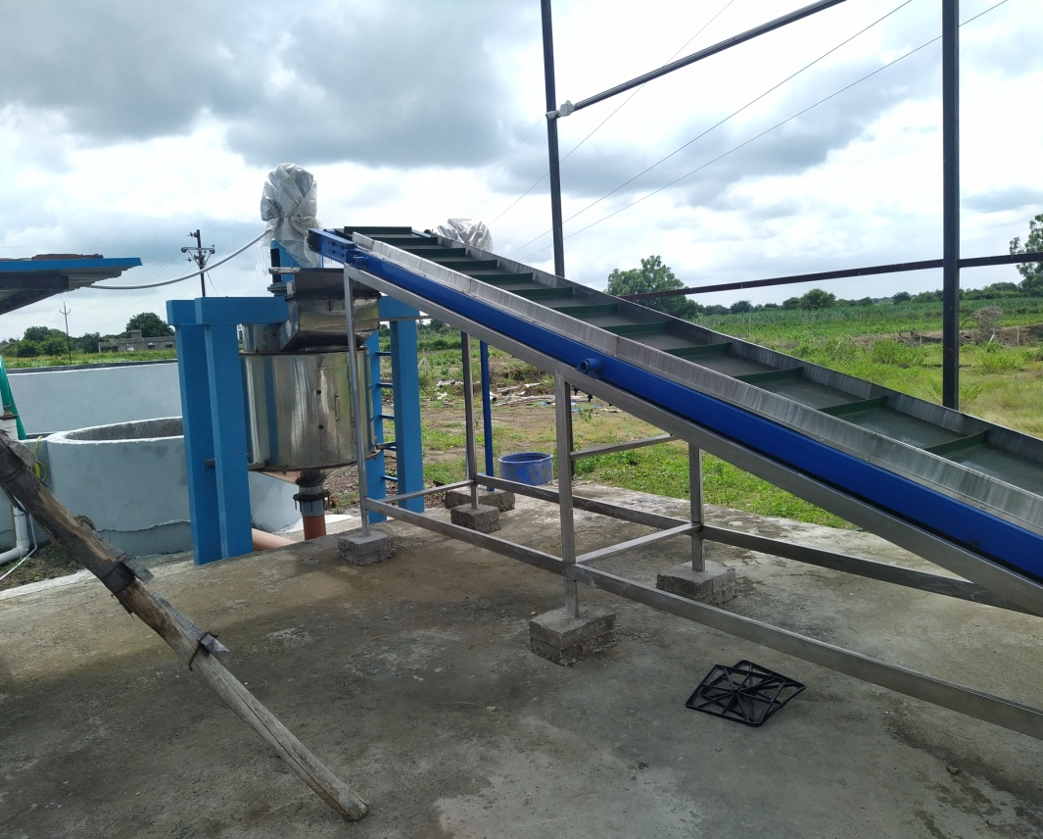
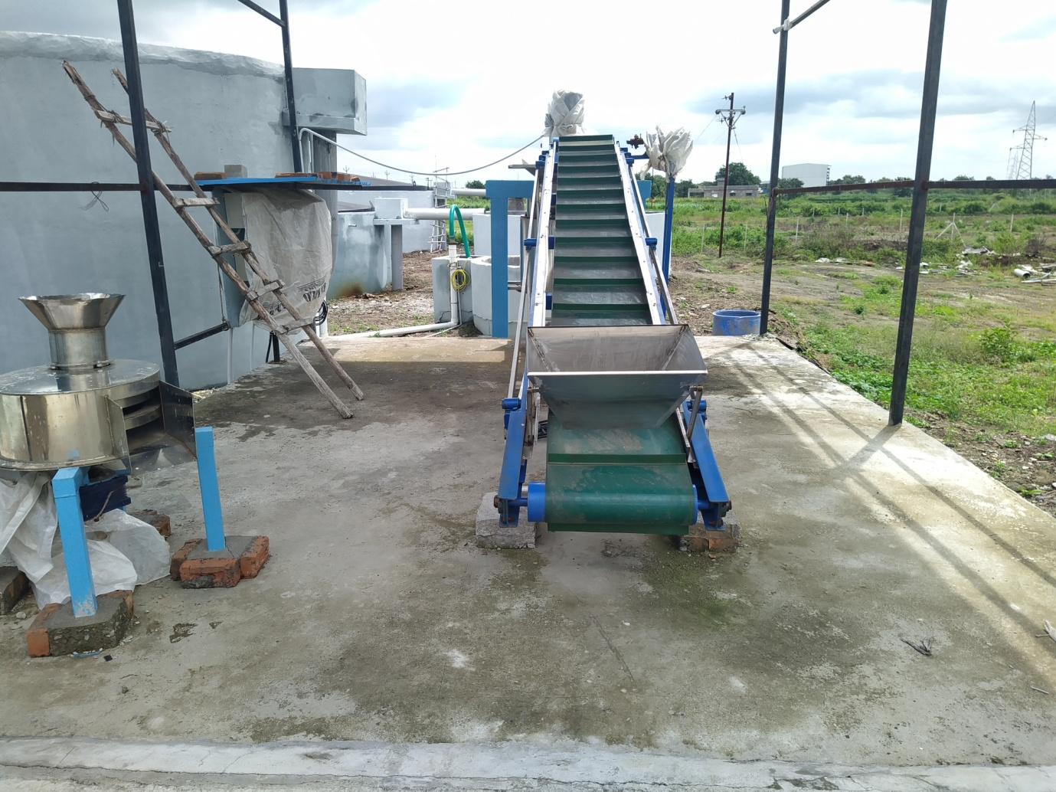
PLANT PHOTOS
FOOD CRUSHER WITH SORTING BELT CONVEYOR

Slide 14
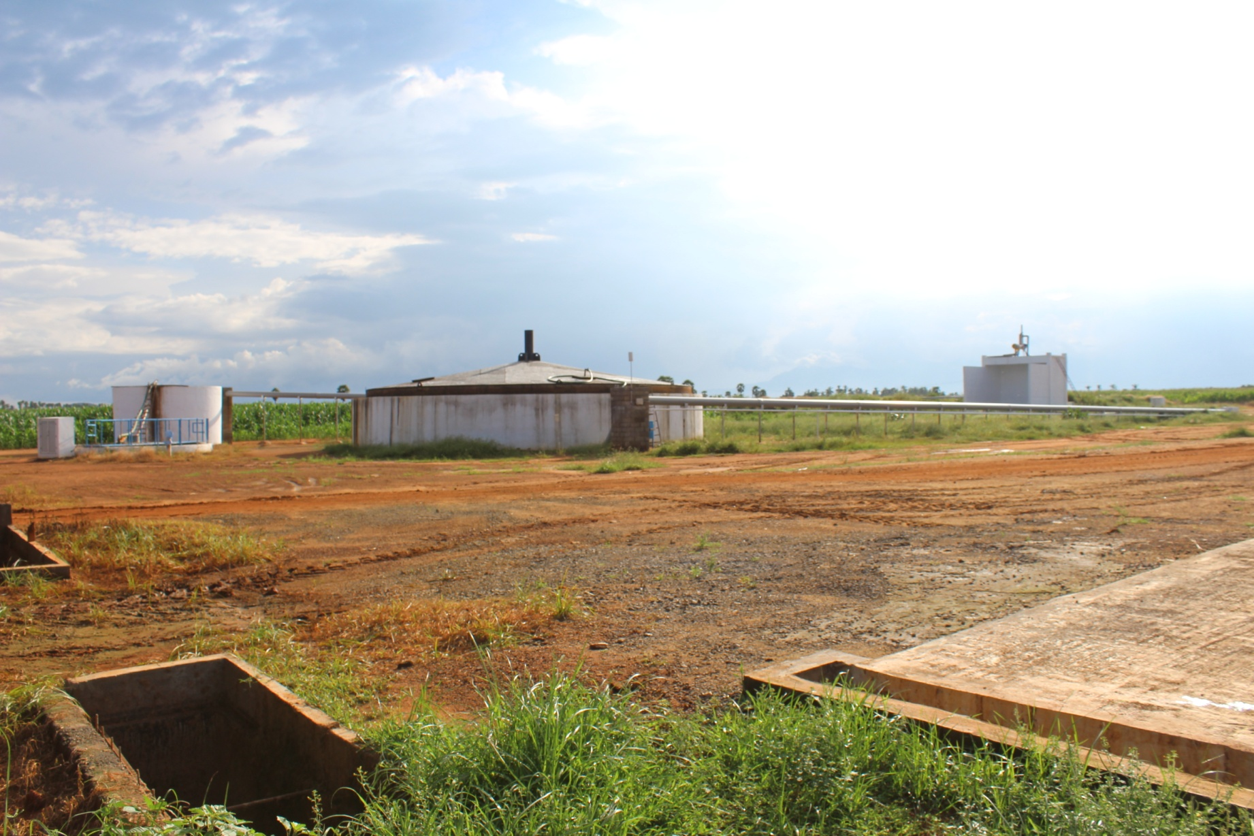
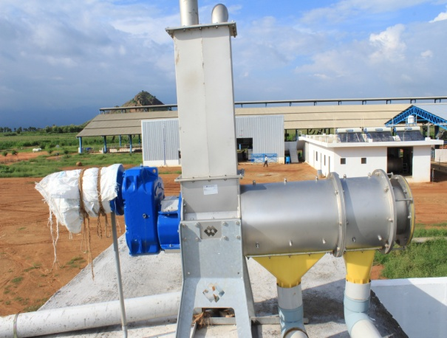
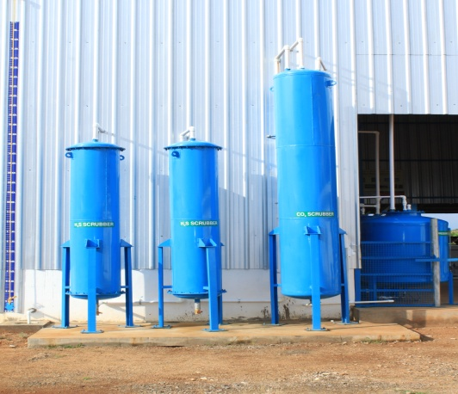
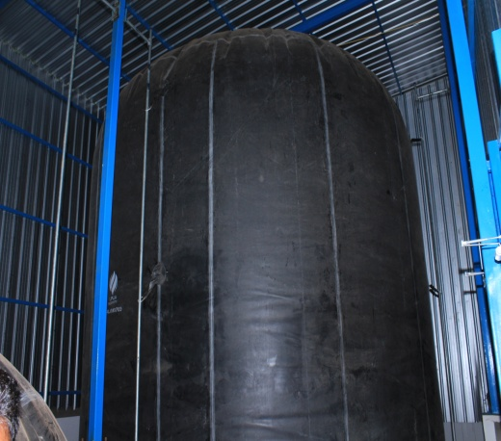
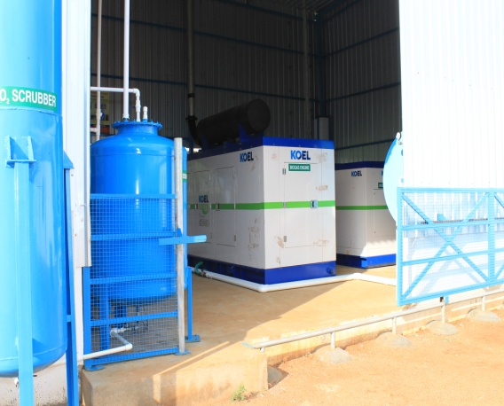
DIGESTER
SLURRY SEPARATOR
SCRUBBERS
BALLOON ROOM
ENGINE ROOM

Slide 15
MANURE PROCESSING FOR BETTER VALUE ADDITION
Digested slurry is very good quality Organic manure, can be used for any crop.
Further value addition as per requirement can be done to fetch better revenue.

Slide 16

BIO CNG PROJECTS BASED ON FOOD AND VEGETABLE WASTE
* Green Roots Solution, Mumbai – 25 TPD – 800 kg CBG production in 2018. ( Under CSR Activities of Godrej Ltd ).
For Smart City Vizag, AP. – 30 TPD – 900 kg CBG production in 2018.

Slide 17
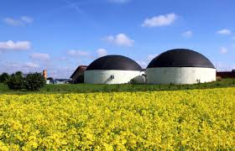
OVERSEAS PROJECTS
7.5 TPD dung waste biogas to power generation plant at Lusaca, Zambia.
5 TPD fruit processing waste to power generation plant at Elvenagri ltd., Dar-E-Salaam, Tanzania.
2.5 TPD dung waste to power generation plant at Gambia

Slide 18
SOCIAL BENEFITS
Job creation for local people
Health improvement - smell reduction, pathogen reduction, disease reduction due to utilization of clean energy & end products use as land fertilizer instead of chemical fertilizer.
Lifestyle improvements

Slide 19
ENVIRONMENTAL BENEFITS
Protect forest
Avoid GHG emissions (CO2, CH4 reduction)
Clean environment

Slide 20
RESOURCE CAN’T BE WASTE
LET’S CONVERT IT TO BEST

